Slide 1
Investigation of H-1B Visa Applications
Catherine Liu
Bard College at Simon’s Rock

Slide 2
Outline
Background
Data
Analysis
Questions being Investigated and Results
Conclusion

Slide 3
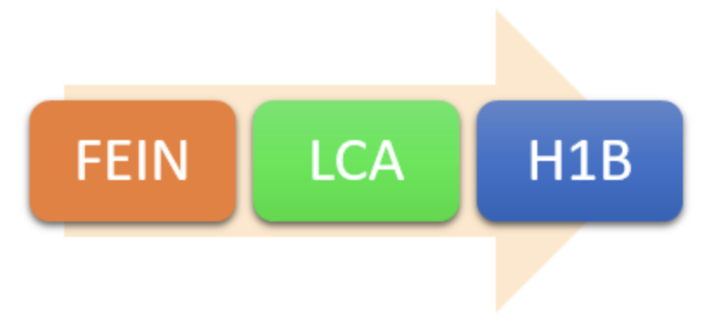
Background
What are H-1B Visas?
For qualified foreigners to work in specialty occupations in the U. S.
Why do we care?
Notes:
- They are visas for foreigners with at least a bachelor's degree to work in specialty occupations in the US. Specialty occupation is defined here by having a minimum entry requirement of bachelor’s degree. When a qualified person found a qualified job, In order to get the Visa,
- Then the employer has to file LCA to Department of Labor to make sure the employee is treated fairly, when certified, the application will be sent to US immigration department for evaluation
- For International college students, once we have completed undergraduate or graduate education in the U.S., if we would like to work in the U.S., we must apply for the H-1B Visa. Therefore, it is useful to study the previous cases and learn about the trends as preparation.

Slide 4
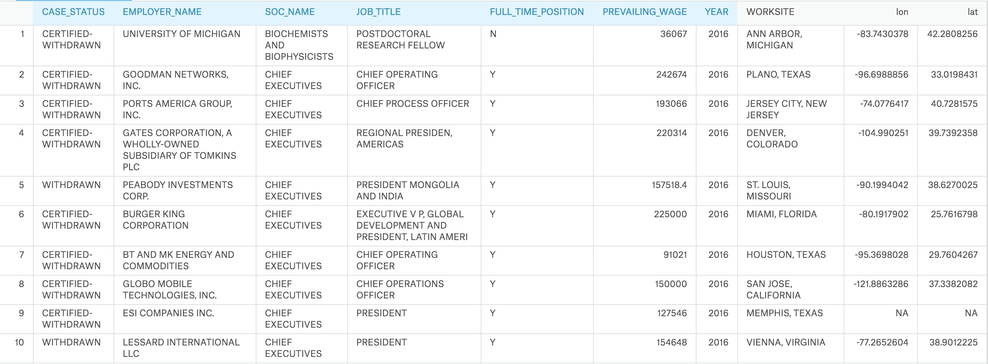
Data
3,002,458 H-1B Visa applications from 2011 to 2016
10 variables
Notes:
From Kaggle.com, The Office of Foreign Labor Certification (OFLC)
Case status after LCA processing, employer name, occupational name as classified by the Standard Occupational Classification System, job title, full time position or not, annual wage, year filed, location of the job, longitude and latitude

Slide 5
Analysis
Questions:
Is the proportion of applicants with technology related jobs increasing over the years?
What is the trend for the proportion of certified applications over the years?
What is the trend for the average annual wages over the years for all applications? For only certified applications?
What is the trend for the proportion of denied applications over the years?
Notes:
- Technology is a field that has been growing significantly, and I’m a STEM student

Slide 6
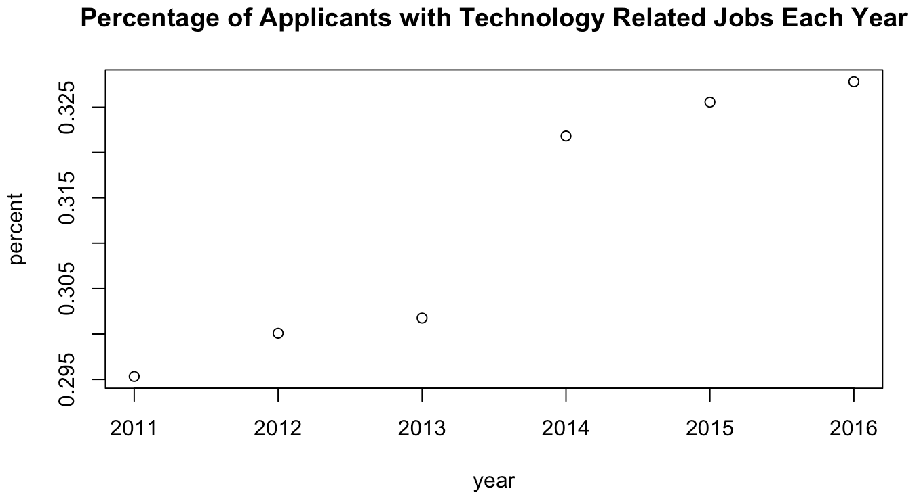
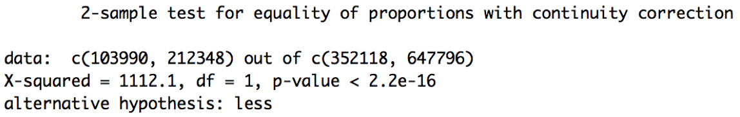
Question 1 Is the proportion of applicants with technology related jobs increasing over the years?
Z test for two population proportions at level 0.05
Yes, the proportion of technology related jobs in 2016 is higher than 2011
Notes:
Use R to filter out technology related jobs by picking out rows with key words like “programmer, software, computer, database” in job titles
null hypothesis is that the proportion of technology related jobs in 2011 is the same as in 2016, and the alternative hypothesis is that the proportion in 2011 is less than that in 2016

Slide 7
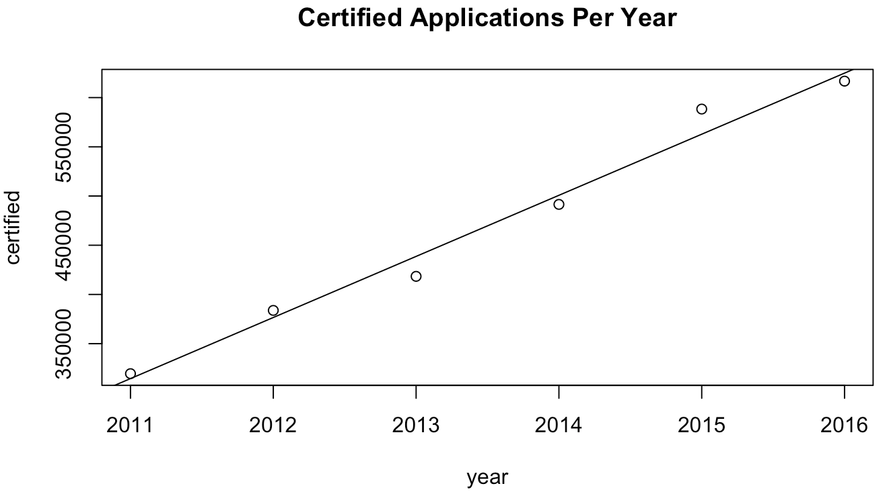
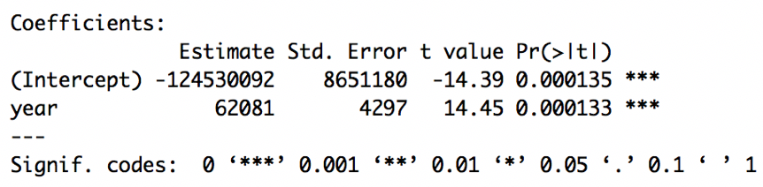
Question 2 What is the trend for the proportion of certified applications over the years?
Linear regression model
Notes:
Based on the figure, the number of certified applications is constantly increasing each year, the linear regression model estimated slope is 62081, meaning the number of certified applications is increasing by 62081 per year.
p-value small, if a model unity test with significance level 0.05 is carried out to see if there is relationship between the explanatory variable (year) and the response variable (certified), then the null hypothesis, that there is no relationship between the two variables, will be rejected
So there is a positive linear relationship between year and the number of certified applications

Slide 8
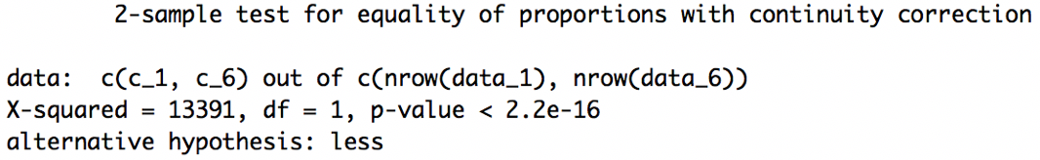
Question 2 Count.
Z test for two population proportions at level 0.05
The general trend for the number of certified applications per year is increasing
Notes:
this positive linear relationship can also be the result of increased total number of applications over the years. Therefore, a z test for two population proportions is carried out to see if there is indeed increase in proportion of certified applications in 2011 and in 2016.
Null hypothesis: equal proportion, alternative, proportion in 2011 is less than in 2016
P-value small, so reject null, the proportion of certified applications in 2011 is indeed less than that in 2016

Slide 9
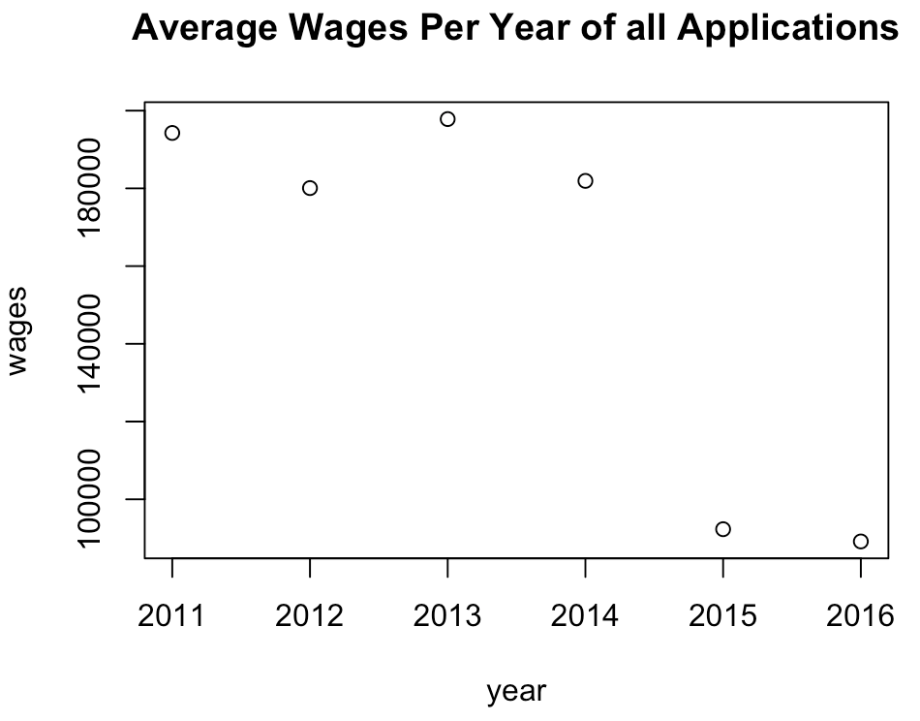
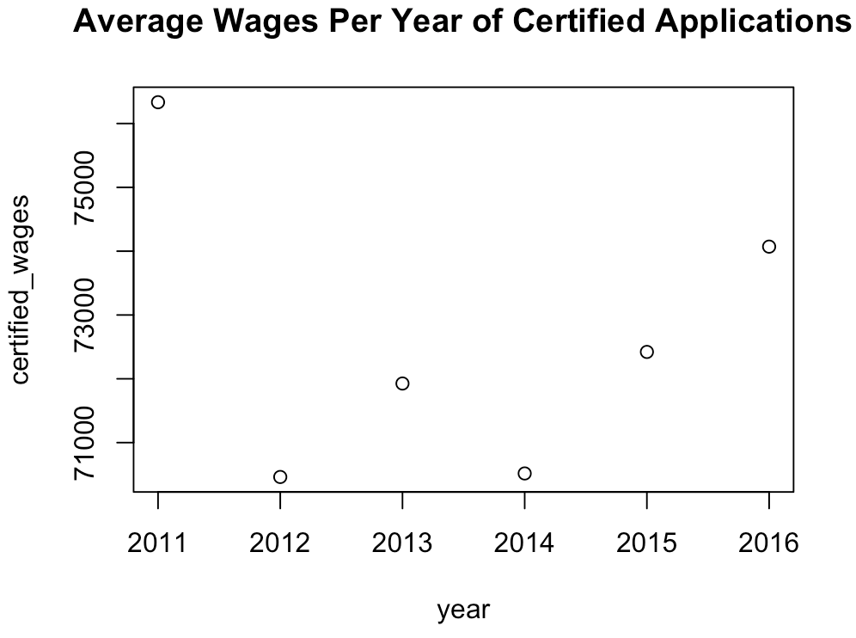
Question 3 What is the trend for the average annual wages over the years for all applications? For only certified applications?
Overview
Notes:
First plot them to have a general sense
Normally one would assume the average wages to be increasing each year since the economy was generally growing between 2011 and 2016 with no significant depressions.
However(…).
On the other hand, although the plot for average wages of certified applications seem to have high variations, the minimum and the maximum only differs by about $6,000, which is significantly smaller than the difference of around $100,000.
It is reasonable to conclude based on the plots that the average wages of certified applications remain the same throughout the years.

Slide 10
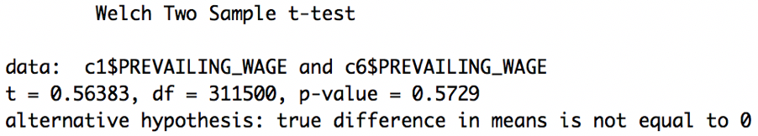
Question 3 Count.
Two-sample t test for approved applications wage means in 2011 and 2016 at level 0.05
Average wages for all applicants decreased significantly in 2015, but the average wages for certified applications remained the same over the six years
Notes:
Null hypothesis: true difference in means for the wages in 2011 and 2016 is 0, meaning they are the same, and the alternative hypothesis is that the true difference is not 0.
Don’t reject null hypothesis
The decrease might be due to improved application process that filtered out applications with unrealistic high wages.

Slide 11
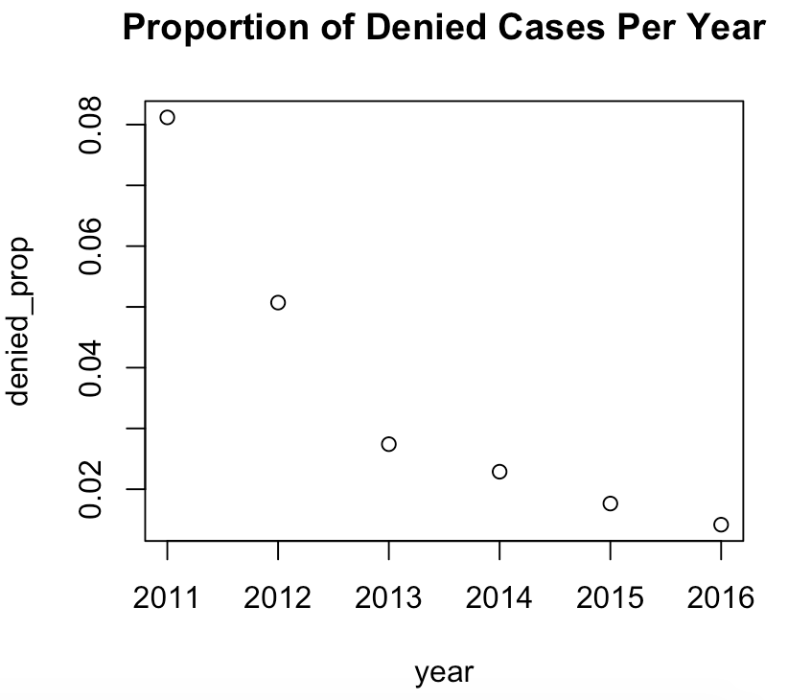
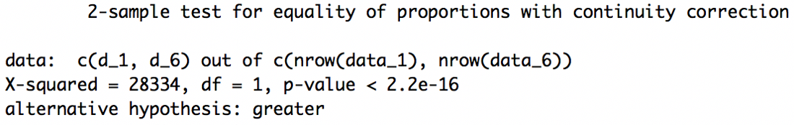
Question 4 What is the trend for the proportion of denied applications over the years?
Z test for two population proportions at level 0.05
The rate of denial is decreasing over the years
Notes:
the general trend for the proportion of denied cases is decreasing over the years
Alternative: the proportion of denial in 2011 is greater than that in 2016
Reject null

Slide 12
Conclusion
The proportion of people with technology related jobs applying for the visa is increasing
The number of certified applications is increasing by about 62081 each year
The rate of approval for the application is increasing, while rate of denial is decreasing
Average wages for certified applications remain the same from 2011 to 2016 at around $73,000 per year
However, this means that the lottery is more and more competitive!
Notes:
However, it is still important to keep in mind that many factors can affect the policies for H-1B Visa, so these trends might not be continued in the near future. There were discussion about raising the minimum wage of applying from 60,000 to 130,000, and there were also talks about cutting down the caps
If I have more time, I would try to figure out which factor has the biggest influence upon approval, which state sponsor the most visas, if it is true that people with tech jobs tend to go to CA or WA, and people with business related jobs want to go to NYC

Slide 13
References
“H-1B Specialty Occupations, DOD Cooperative Research and Development Project Workers, and Fashion Models.” USCIS, U.S. Citizenship and Immigration Services, 4 Mar. 2017, www.uscis.gov/working-united-states/temporary-workers/h-1b-specialty-occupations-dod-cooperative-research-and-development-project-workers-and-fashion-models.
Naribole, Sharan. “H-1B Visa Petitions 2011-2016.” Kaggle, Kaggle, 28 Feb. 2017, www.kaggle.com/nsharan/h-1b-visa.
“U.S. GDP 1990-2017.” Statista, Statista, Jan. 2018, www.statista.com/statistics/188105/annual-gdp-of-the-united-states-since-1990/.

Slide 14
Questions?

Slide 15
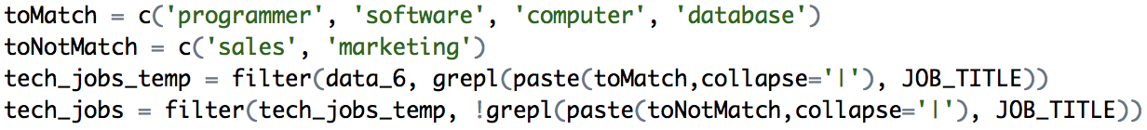
Some R Code
Filtering technology related jobs

Slide 16
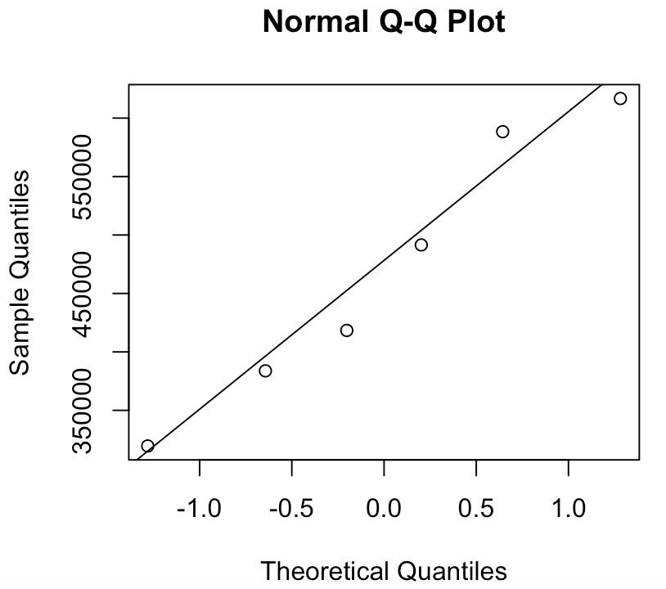
Why is Linear Regression Appropriate for Question 2?
Check assumptions – response variable has to have a normal distribution and equal variances – normal plot
Notes:
- the data points produce an approximately straight line, and all fall approximately on the same line. Therefore, the normality and equal variances assumptions are not seriously violated, and the linear regression can be used in this case.

